Slide 1
TE 271: Analog Communication Systems Lecture 5 Examiner: M. S. Ellis, PhD smellis.coe@knust.edu.gh 057 904 7591
October 10th , 2016

Slide 2
Reference material
A. Yadav, “Analog Communication Systems”, University Science Press, New Delhi, 2008.
S. Sharma, “Communication Engineering”, First Ed., S.K. Kataria & Sons, New Delhi, 2011.
T. G. Thomas, “Analog Communication”, McGraw hill, New Delhi, 2007.

Slide 3
ANGLE MODULATION
Angle modulation encompasses Frequency Modulation and Phase Modulation
Here, the phase angle of the sinusoidal carrier wave is varied
Unlike Amplitude Modulation, the bandwidth of the angle-modulated signal is much greater than twice the message bandwidth
Additionally, the spectral components of the modulated signal is not easily related to the message spectrum in a simple fashion (system complexity)
System complexity comes with improved noise resistance and interference

Slide 4
Phase and Frequency Modulation
In PM, the instantaneous phase deviation of the carrier is proportional to the message signal: ф(t) = kp m(t)
In FM, the instantaneous frequency deviation of the carrier is proportional to the message signal: dф(t)/dt = kf m(t)
In summary, the expression of an angle modulated signal is given as:
A cos [ ωct + kpm(t) ] ---phase modulated wave
Acos [ωct + kf m(t) ]

Slide 5
Side Band Techniques
The equation for an AM wave is given by:
V = Vc cosωct + maVc/2 {cos(ωc + ωm)t + maVc/2 cos(ωc - ωm)t….….(10)
Purpose of modulation is to send the weak message signal with the help of a carrier, NOT to send the carrier
Now, the carrier can therefore be removed without affecting the net content of the information. This is known as suppressed carrier (SC)

Slide 6
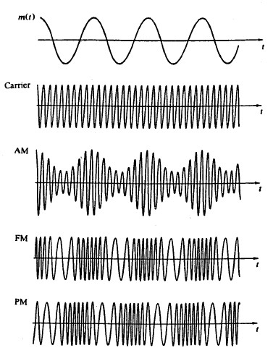

Slide 7
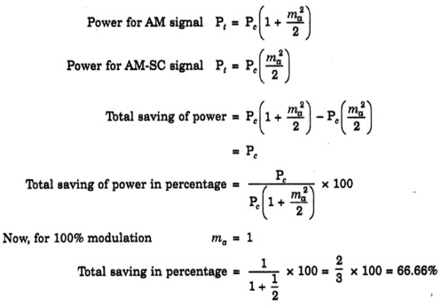
This will also require less power without affecting the net content of the information Proven below as;
By removing the carrier, 66.66% of the total power can be saved without affecting the net content of information

Slide 8
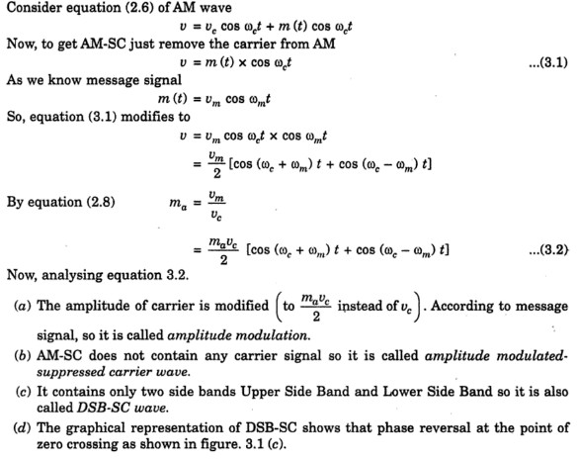

Slide 9
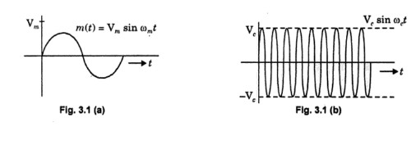
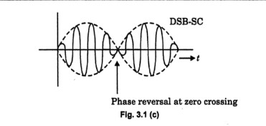
REPRESENTATION OF AM-SC WAVE

Slide 10
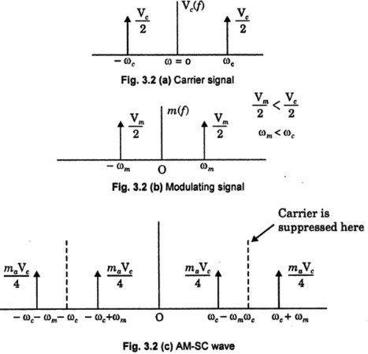
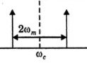
SPECTRUM OF AM-SC WAVE
Only positive freq for practical use

Slide 11
Generation of DSB-SC
Methods of generation a suppressed carrier AM wave is the same as discussed in generation of an AM wave, i.e.
Linear Time Variant Circuit
Non-Linear Circuit
Similarly, an example of a linear time variant circuit for DSB-SC generation is a chopper circuit (also called switching circuit or ring modulator) ……. Refer from Lecture 3
Likewise, an example of a non-linear circuit used to generate DSB-SC is a balanced modular is used to generate…….. Refer from Lecture 3

Slide 12
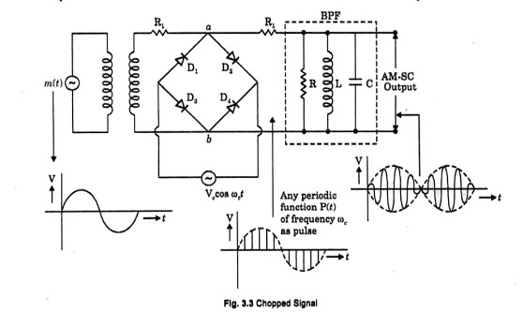
All diodes are in forward bias for positive half cycle of carrier signal. Therefore no signal across resistance R (input of BPF)
All diodes are in reverse bias so diodes acts as an open circuit. Therefore signal for negative cycle appears across resistance R (input of BPF)

Slide 13
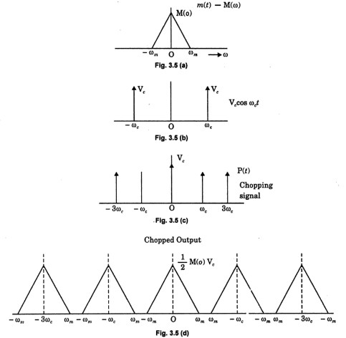
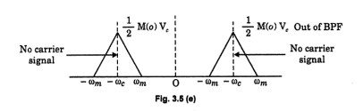

Slide 14
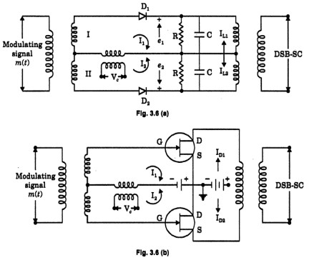
A balanced modulator (non-linear circuit) for DSB-SC modulation

Slide 15
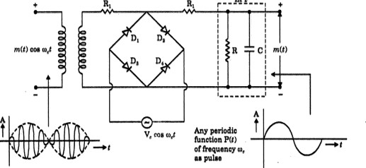
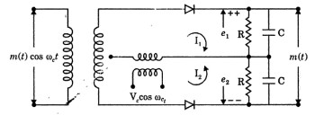
Demodulation of DSB-SC signal
Using Linear Time Variant Circuit
Using Non-Linear Device

Slide 16
Single Side-Band (SSB) Transmission
As discussed earlier under DSB-SC, there is really no need to transmit the carrier
By doing so we can save power and maintain the same bandwidth as in the case of AM
V = maVc/2 [cos (ωm+ωc) t * cos (ωc-ωm)t] ....DSB-SC wave
The DSB-SC wave contains two identical sidebands
There is really no need to transmit both side bands if only one can be used to transmit the information
V = Vc cos ωct + maVc/2 [cos (ωm+ωc) t * cos (ωc-ωm)t]

Slide 17
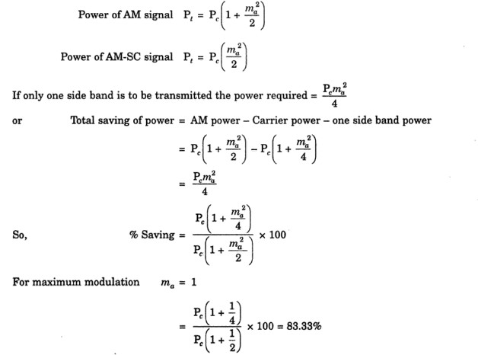
By transmitting a single side band signal (SSB), 83.33 % of the total power has been saved
Transmission bandwidth requirement also drops by half
Reduced noise
Reduced fading
Applications where SSB is used include ??

